Slide 1
Toilet Soap market analysis
Nielsen, YTD2014 (JFMA2014)

Slide 2
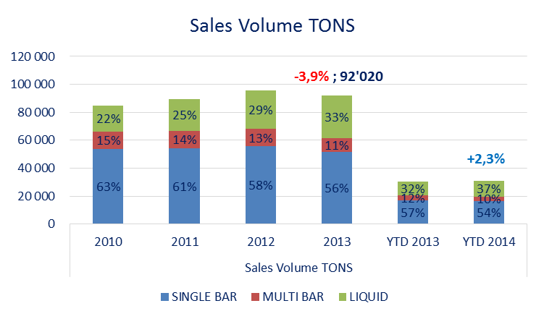
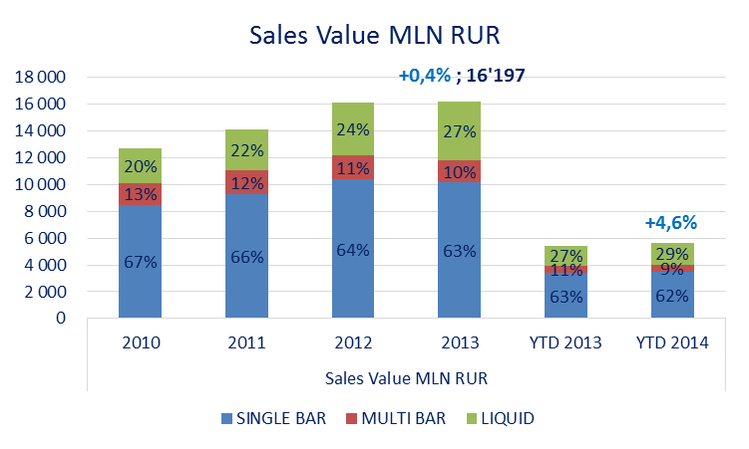
Toilet Soap Market Dynamics: subcategories

Slide 3
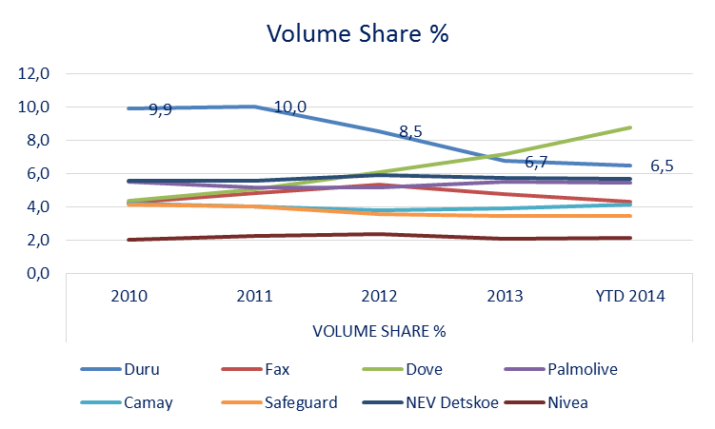
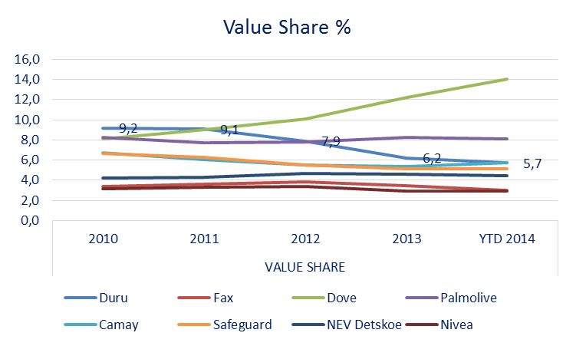
Toilet Bar Soap Market: players (brands)

Slide 4
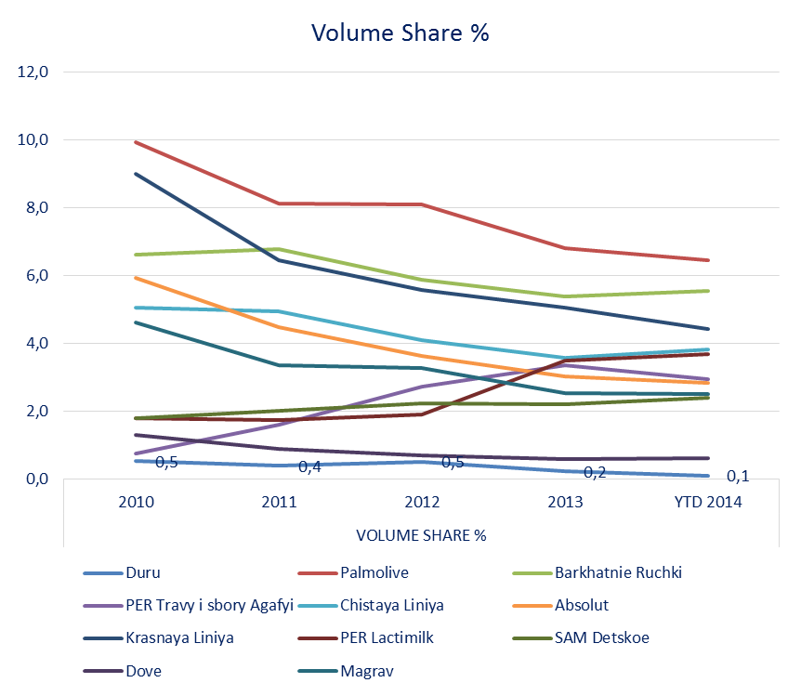
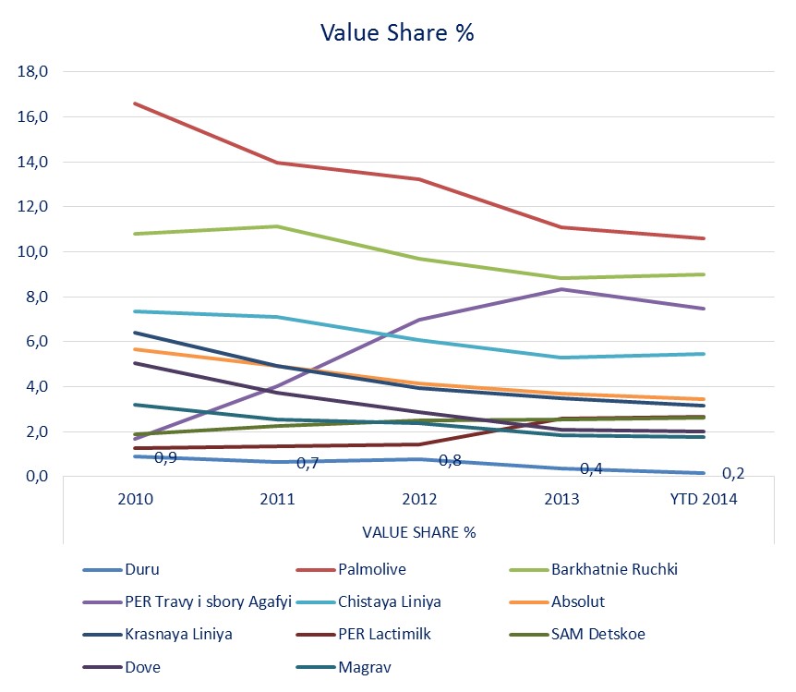
Toilet Liquid Soap Market: players (brands)

Slide 5
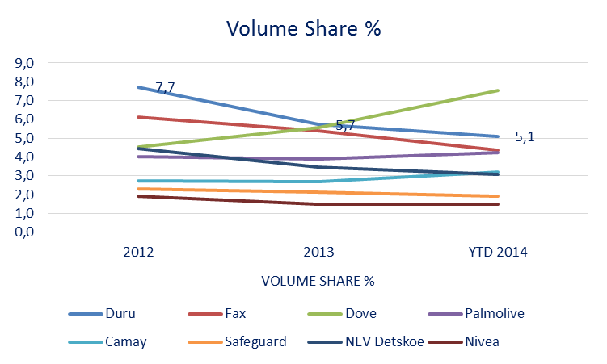
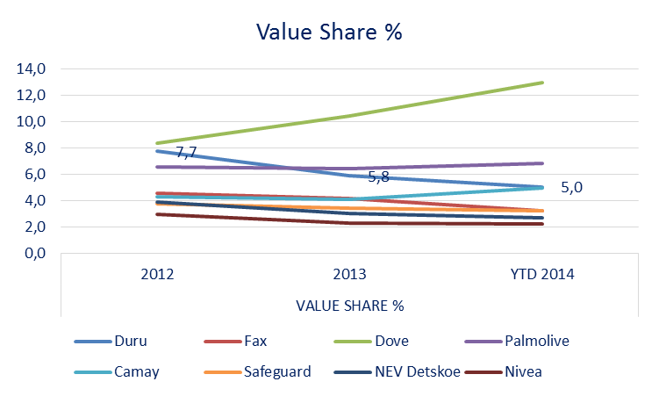
Toilet Bar Soap Market: Volga region players

Slide 6
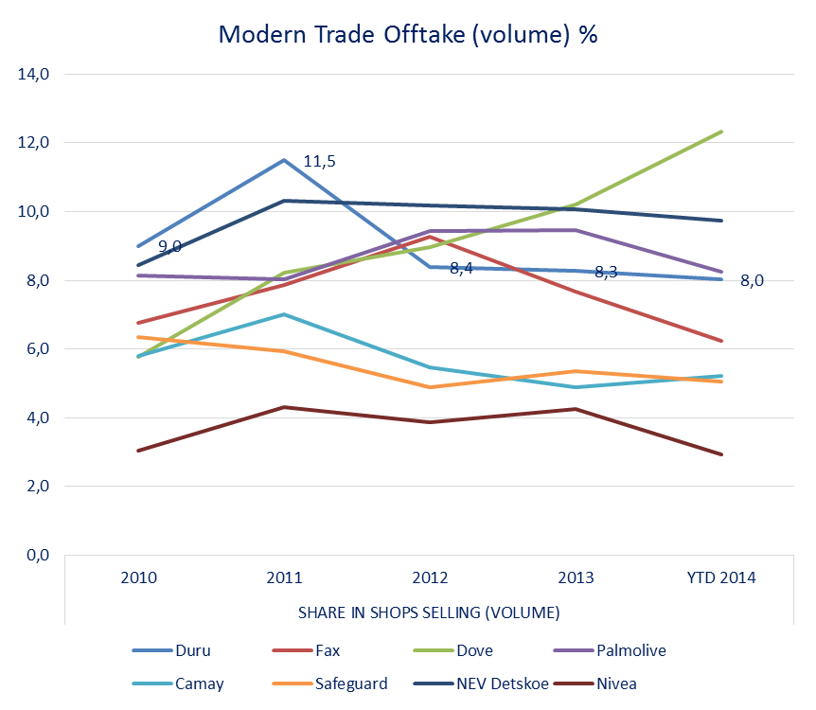
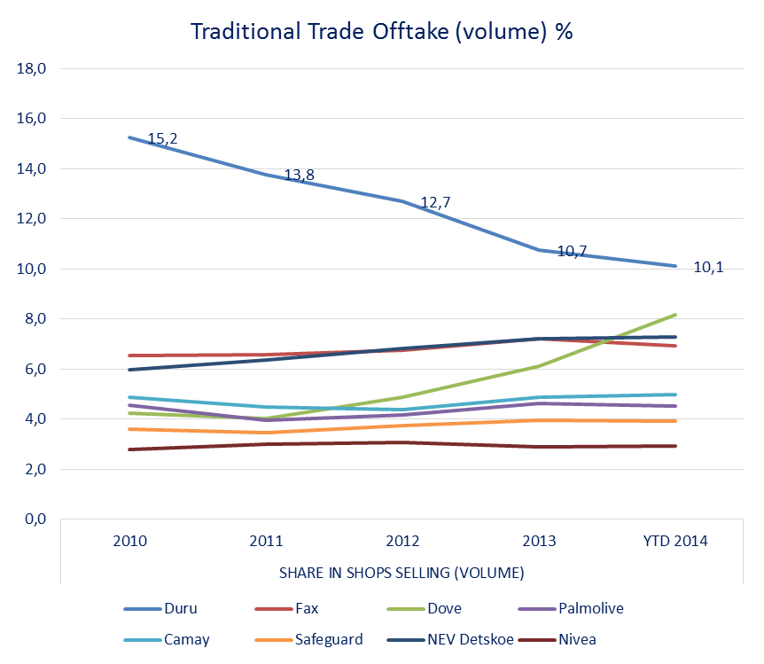
Toilet Bar Soap Market: Offtake dynamics by channels

Slide 7
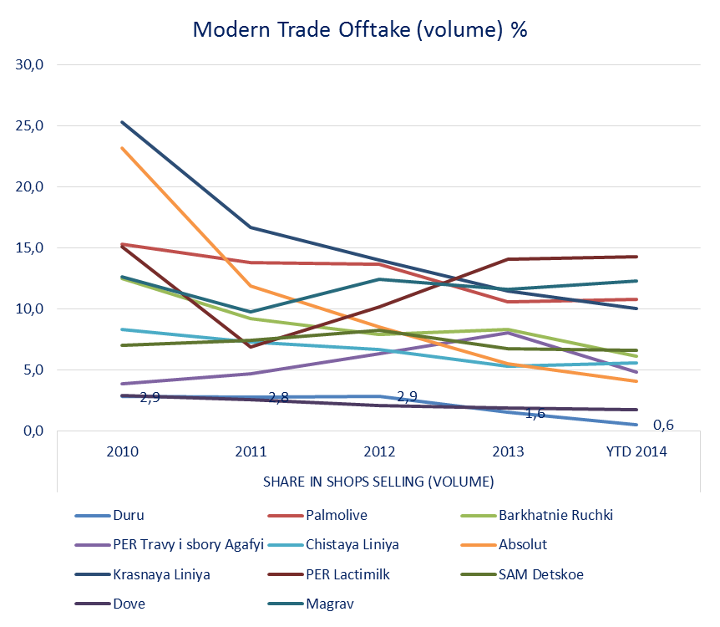
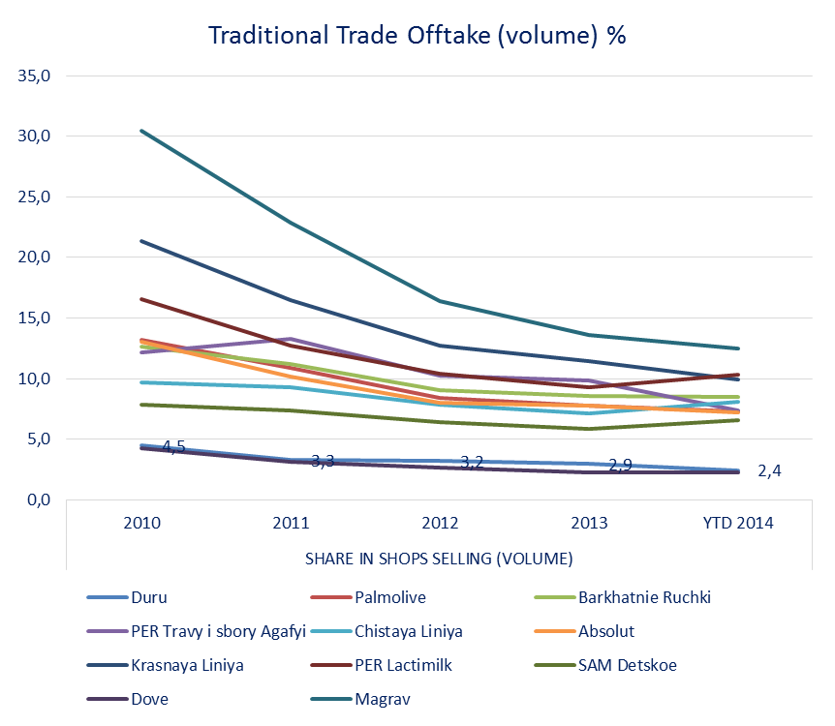
Toilet Liquid Soap Market: Offtake dynamics by channels

Slide 8
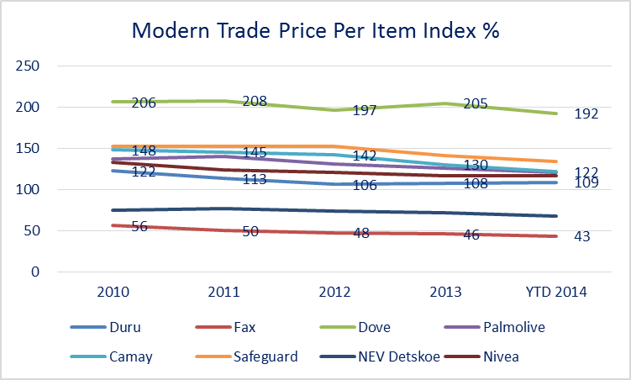
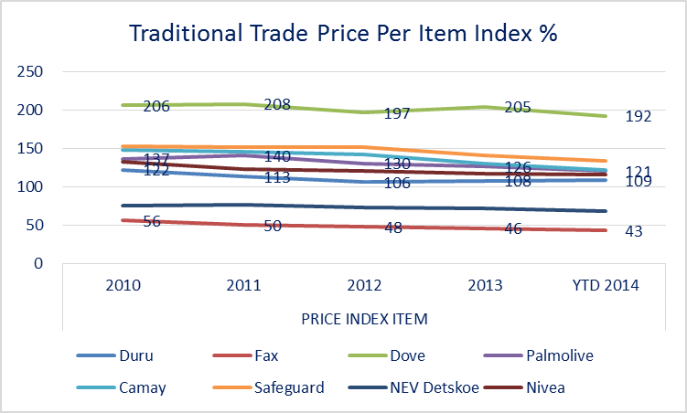
Toilet Bar Soap Single Market: Price dynamics

Slide 9
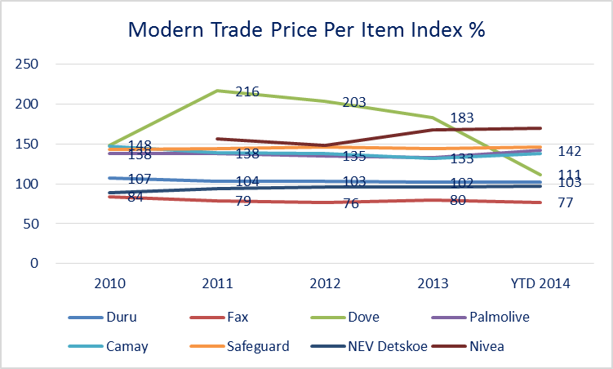
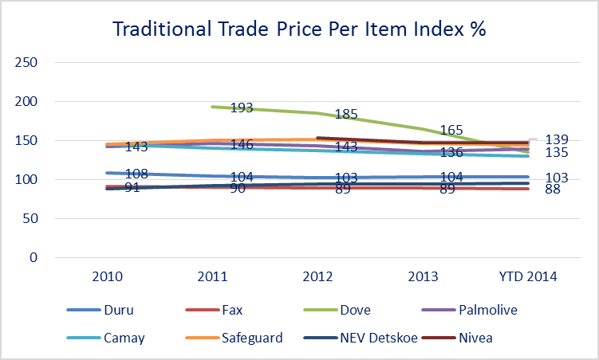
Toilet Bar Soap Multi Market: Price dynamics

Slide 10
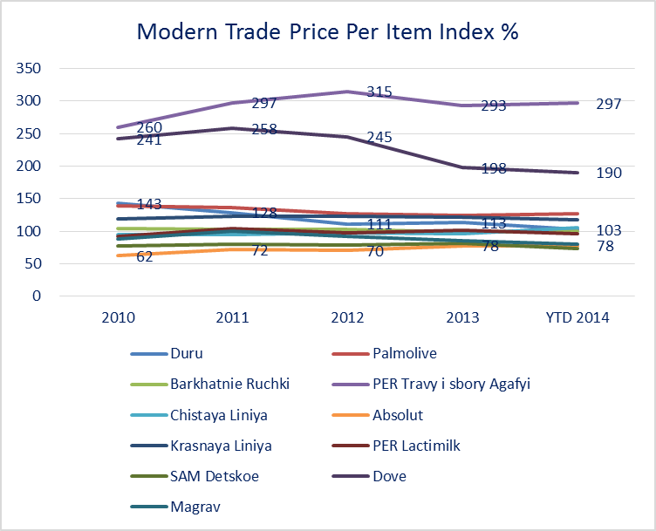
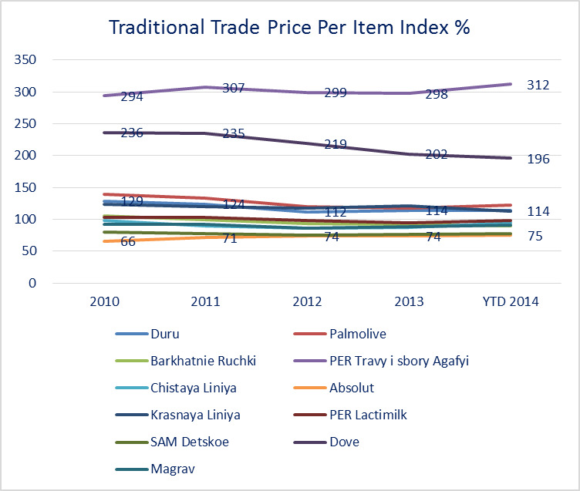
Toilet Liquid Soap Market: Price dynamics

Slide 11
Toilet Soap Market: best SKUs single / multi / liquid
SINGLE
MULTI
LIQUID

